Slide 1


Slide 2
What is this call all about?
  Intro to James
  A Few Things For You To Update
  System Updates/New Features
  What’s Coming Next?
  Contest

Slide 3
Who Is James Patchett?
19 years in Franchise/Corporate Operations
  The Little Gym
  Huntington Learning Center
  Home Care Assistance (now TheKey)
How I came to ENGYJ
Focused on: Operational Efficiency without sacrificing quality.
Future Focus
Notes:
From Michigan Originally through college
Former Golf Professional
Been playing since I was 3 and quickly realized that it was not the business for me
Moved to AZ in 2005 and started my career in business with The Little Gym Franchise
Corporate Trainer
IT Business Analyst
IT Project Manager
Asst Brand Manager – Rebranded the entire business
Business Consultant/Franchise Coach
Missed the water
Golf was great
Didn’t want to shovel snow
Chose to move to FL , Finger on Map
In 2013 I closed my eyes and put my finger on the map and it landed on Clearwater Beach, FL
Packed up and moved
Took a Franchise Business Consultant role with Huntington Learning Centers
The owners of the company were very numbers driven (doctorate in Statistics)
Learned a lot about how to use the numbers to tell a story
In 2016 I took a Director of Franchise Support role with Home Care Assistance
When I started, I was given the under-performing franchise offices to support
My goal was to either help them grow or help them exit the system.
I did just that and was able to bring 90% of those offices to a profitable state and the other 10% I exited from the system.
I was then offered the opportunity to work with the top performing franchise offices
I used my experience at Huntington to dive deep into the numbers to see how we could still create explosive growth in our top performing offices. It was then that I discovered a different model of home care and through some pilot offices I was able to produce a 23% YOY growth at the highest level and a 60% growth with the mid level offices.
At our next national franchise conference we showed the results and had the buyin from 80% of the franchise community. The revenue growth was incredible and the overall net profit increased to above 30%
I then went on to oversee our international operations and growth through Canada and Australia as well as research expansion in the UK
In late 2020 Home Care Assistance rebranded to TheKey and I was brought to the corporate side of the business to oversee the Business Support Group.
TheKey then went through nearly $500M in acquisitions in a 2 year period buying back most of the franchise offices and several outside agencies both big and medium sized. My group was tasked to integrate those acquisitions to TheKey operations systems and processes. After nearly two years of very long days I burned out and left the company in Feb of 23. I took about 10 months off and played a lot of golf and refreshed.
Throughout my time at Home Care Assistance working with franchise offices I was also fortunate to work with SABA and met Hafiz. I watched him produce amazing results for our franchise owners and collaborated often to drive the businesses forward. Our corporate offices tried to bring their SEO in house and could not compete with the results SABA was producing. Hafiz and I always kept in touch because our minds thought the same way and we would come up with great strategies to grow the offices…… Fast forward years later we continued to keep in touch even after I left and late last year he approached me about the ENGYJ platform
AMAZING – SUCH GREAT POSSIBILITIES

Slide 4
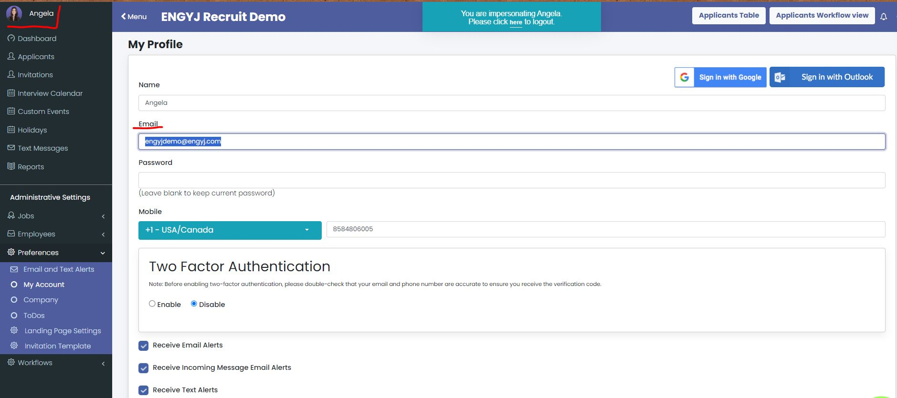
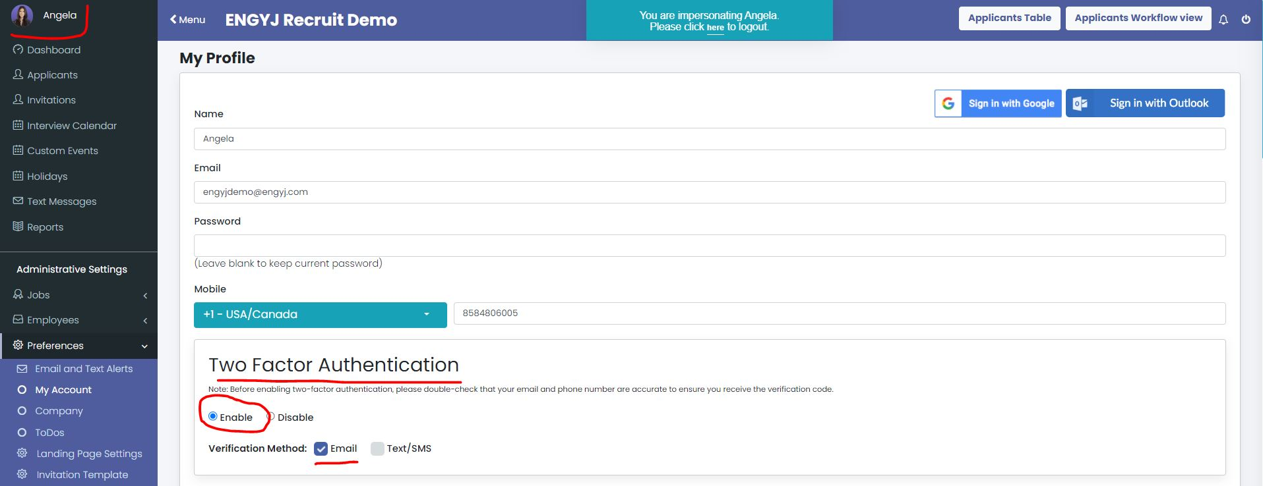
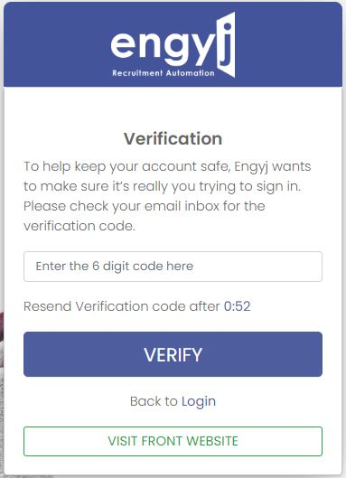
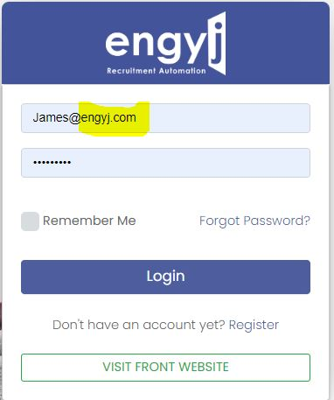
A Few Things For You To Update…
2 Steps
Step 1: Update your email address
  If Your ENGYJ Login has: @Engyj.com
    Please change this to your WORK email in your profile
    Click Save before proceeding to Step 2
Step 2: Two Factor Authentication
  Enable in your profile
  Click Save
Notes:
Before I jump into the updates and new features there are a couple of things we would like to ask from you….
If you are logging into ENGYJ under your name and you see that your login we need you to update the email address in your account.
Login to your account then click on your profile in the upper left corner
You will see you email address there, please change this to your WORK email address
You can set your password to whatever you want at this time as well
Scroll all the way to the bottom and click Save.
Do not try to do step 1 and 2 at the same time…
Once you have saved your email and password please log out of engyj and check your email for a verification link. Click that link to verify. Then go back to ENGJY and login with your work email and the password you created. Move on to step 2
Go back to your profile and select ENABLE for the Two Factor Authentication. You can choose to receive your verification notifications through email or text (has to be the phone number in your account) recommend doing email.
Scroll to the bottom and click save.
It is important to do this for security reasons and to keep your data safe.
Now when you login to ENGYJ you will be prompted to enter the verification code. This will only be when you initially login in the morning as long as you keep it open.
Once enabled you will receive a confirmation link to confirm your change and going forward you will occasionally need to enter an authentication code upon login which will be sent to your email or phone which is your choice when enabling.

Slide 5
System Updates/New Features
Messaging & Notification Updates
Reporting Updates/Additions
Add-On Updates

Slide 6
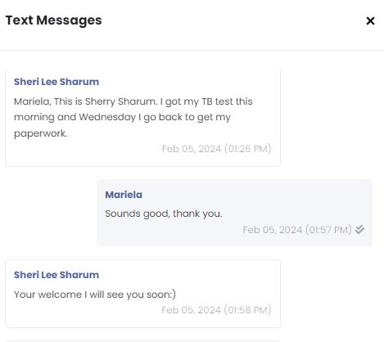
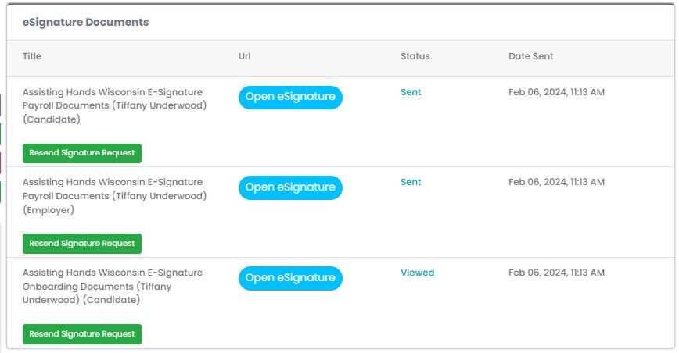
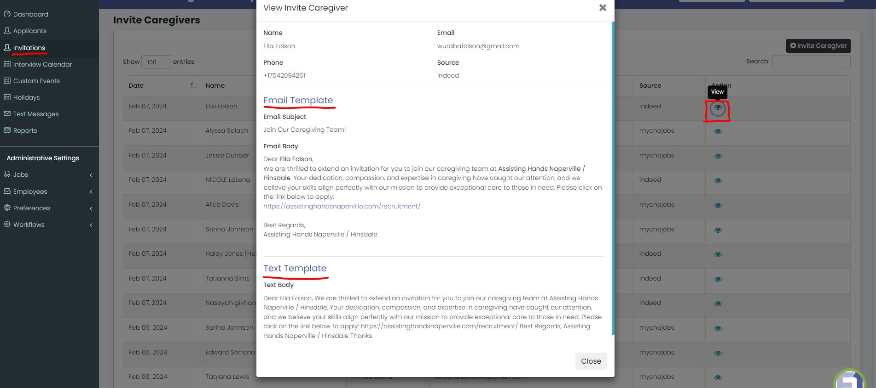
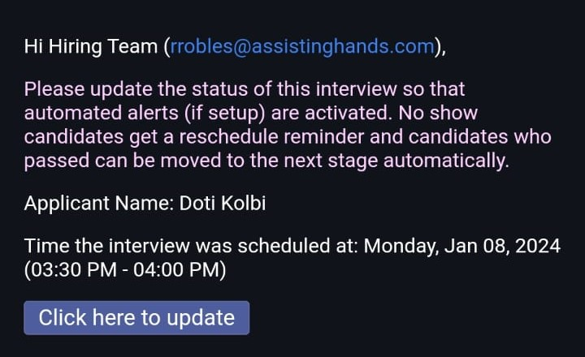
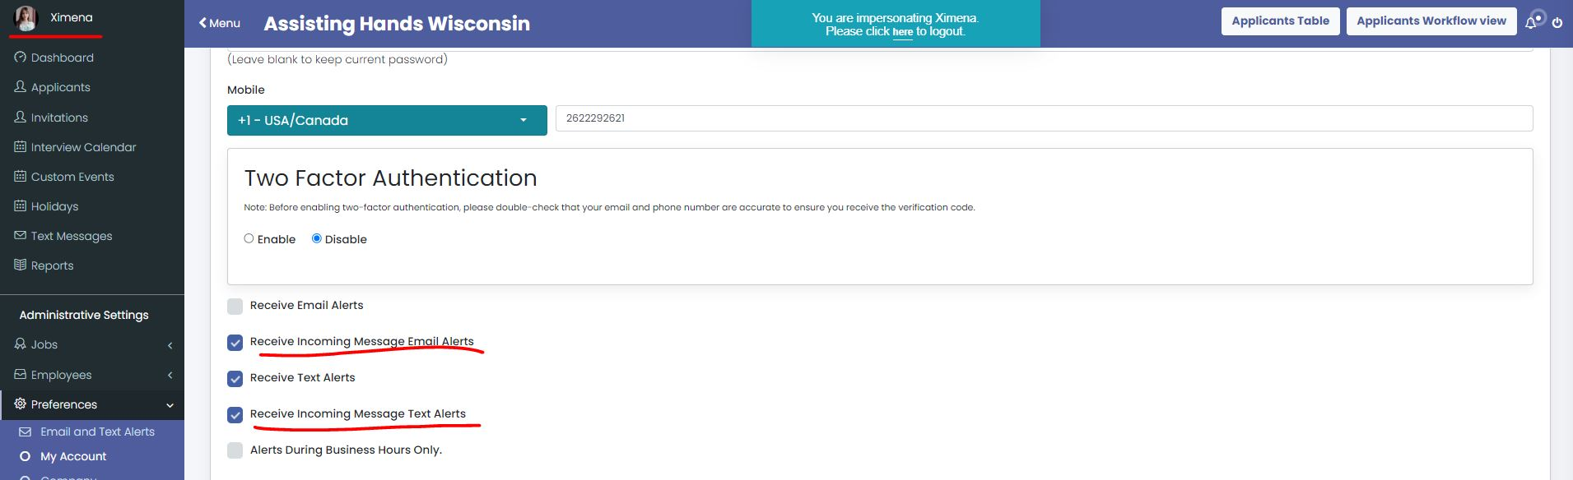
Messaging & Notification Updates
Email Notifications enabled for Hiring Managers to change Interview Status.
Removed weekend condition for reminders so they will now be sent over the weekend
Personal Text Message – Now displays the name of the person who sent the message
Invitations now show the actual messages being sent
E-Signature/HelloSign Resend Fixed – Caregiver Profile
Request Documents Reminder Fixed – Doc number was sending instead of doc title
Incoming Text/Email alerts can now be enabled or disabled within your profile.
Notes:
Interview Status Change – It is important o ensure that candidates are up to date and you know where they are in the process so they do not fall behind or slip through the cracks… This will help you reduce the Time to hire.
Removed Weekend Reminder Condition – In the past we did not send reminders to the applicants over the weekend. For example if the applicant had an appointment on Monday we did note send the 1 day (24 hour) before reminder as to not bother them on the weekends. We have decided after speaking to many of you that it would be beneficial to send these on the weekend and have made this change.
Invitations - One great feature we rolled out is the ability to invite someone directly to the chat session to have them complete the pre-screen. Previously if you had the ability to do resume lookup on MyCNAJobs you would have to reach out and gather information from them. Or if you had someone call you, you would have to manually enter their information by adding a new applicant. Now you can simply invite them directly by sending them an invitation to the landing page where they can use the chat bot. You of course can still enter them manually if you like.
Resend digital docs – For those of you who are using the digital document feature to send your hiring and onboarding docs electronically to your applicants we have fixed the ability to resend those docs to the candidate. If you are not using this feature I would highly recommend you consider it as it will shorten your days to hire timeframe and make the process of onboarding easier for the applicant as well as the team and it removes the paper. If you have questions about this feature just reach out to me to discuss.
Request Documents (credentials) – the bug that caused the document page number to go out in the title field has been fixed and the document title is now showing.
Text Message – IF you did not know, when you receive an incoming message from the applicant via text but in your email inbox, you can respond to the email you received and it will convert that message back to text and send ot the caregiver vs. having to go in and respond through the system

Slide 7
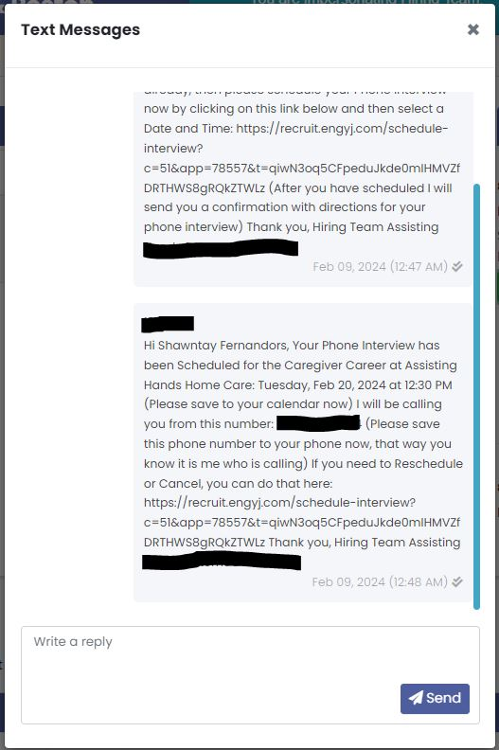
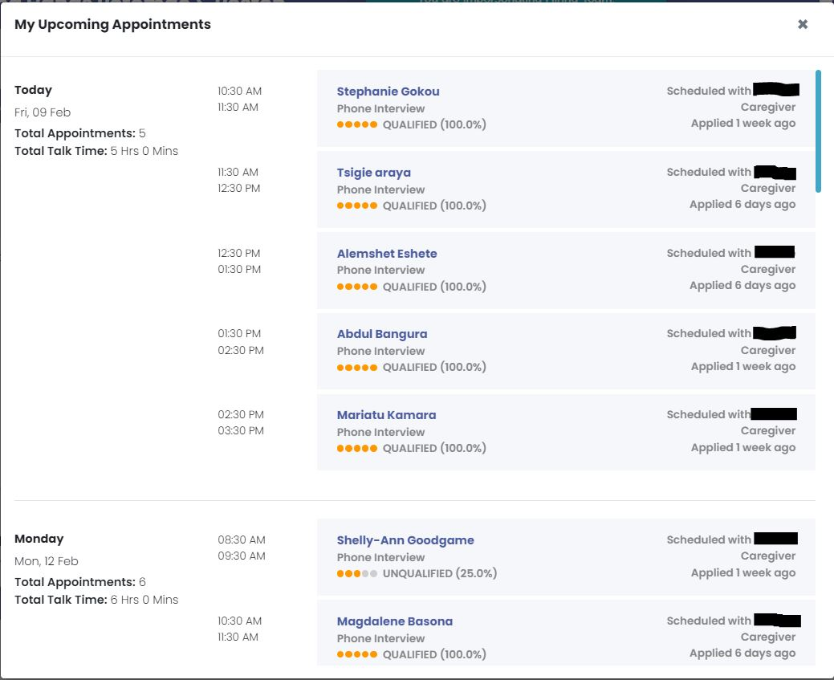
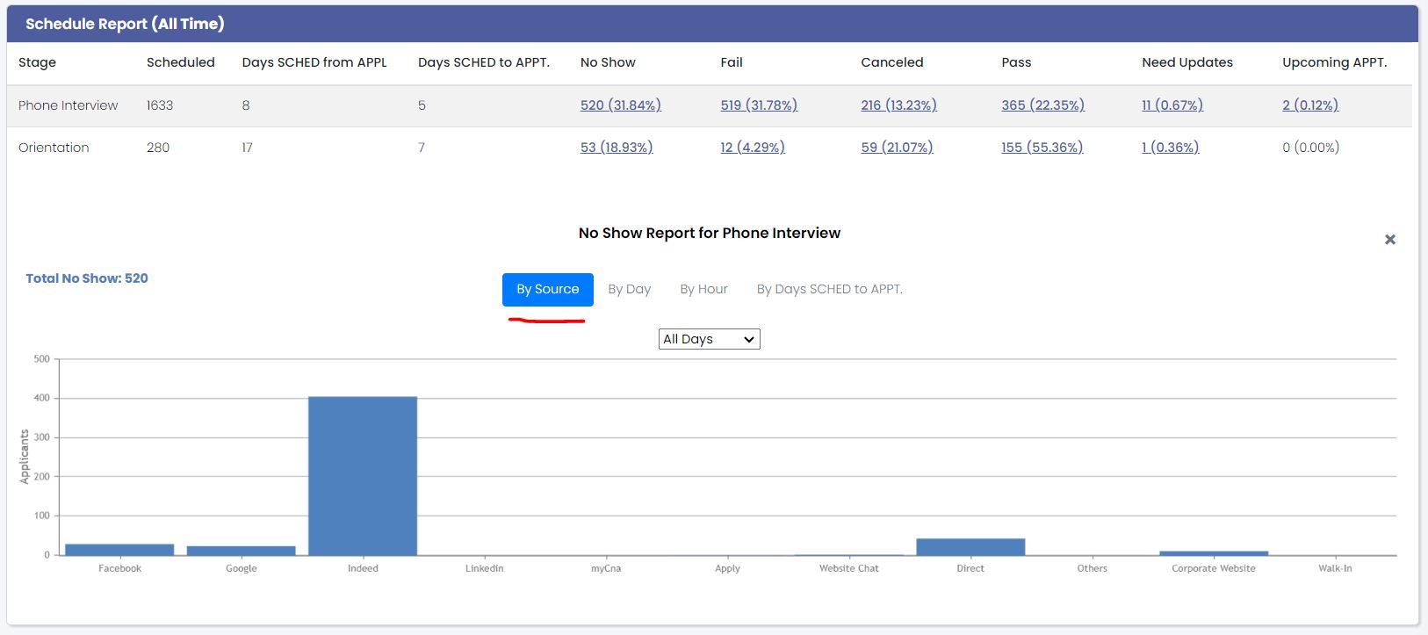
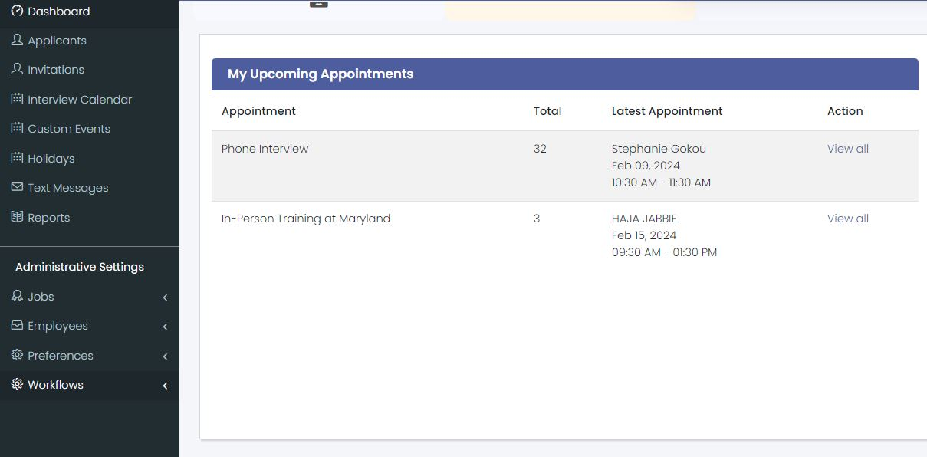
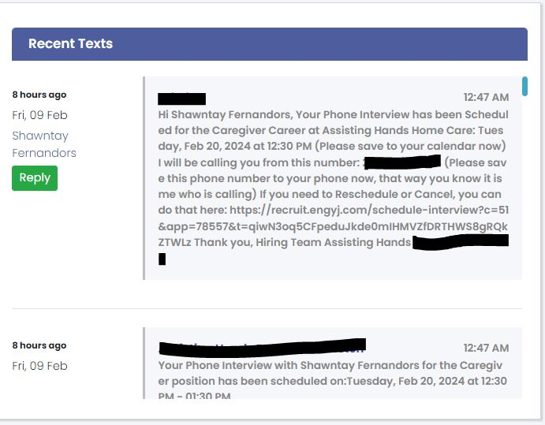
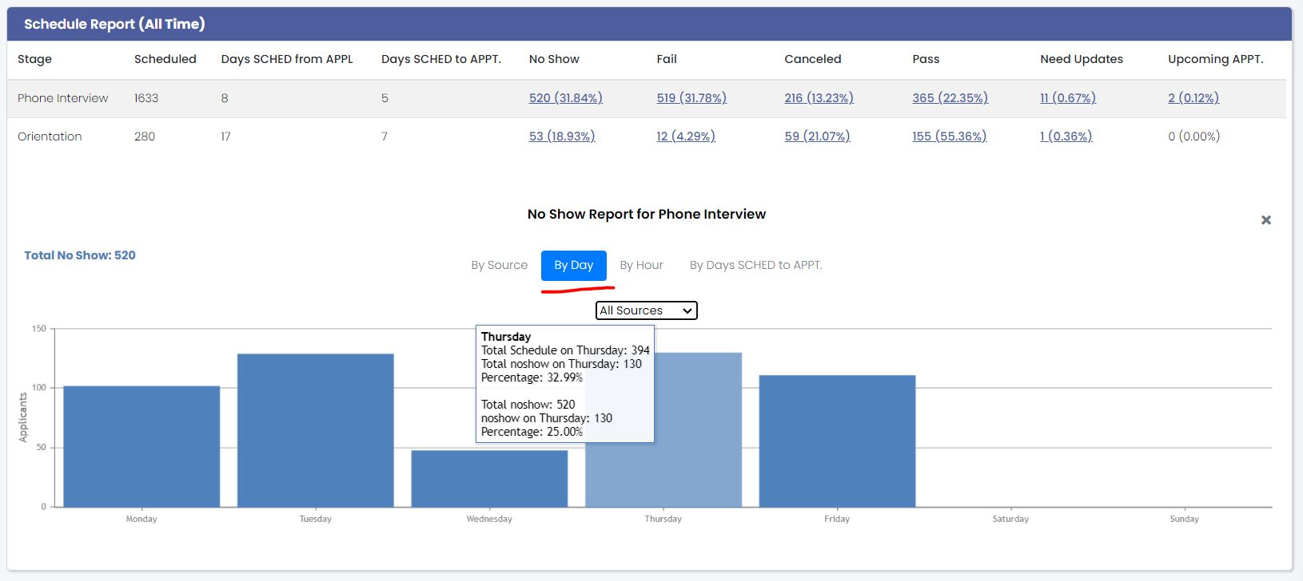
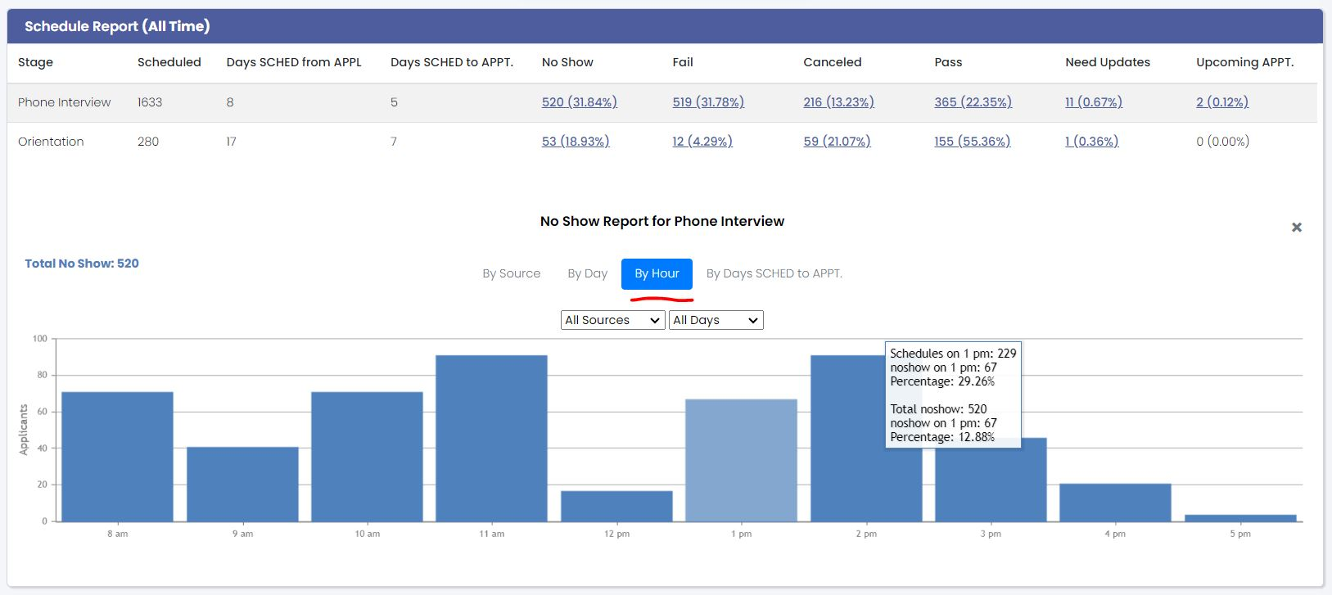
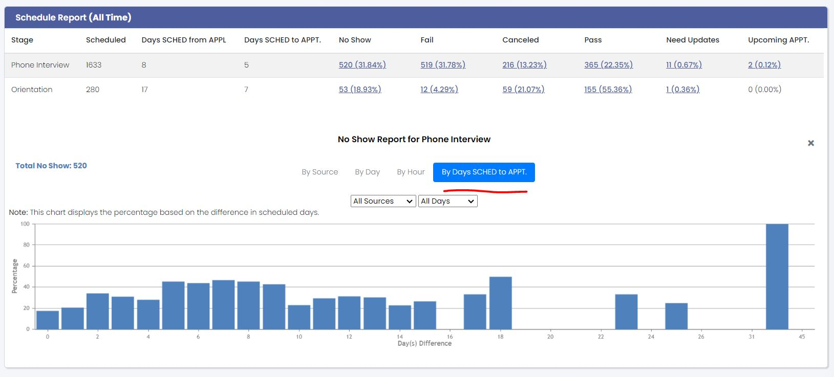
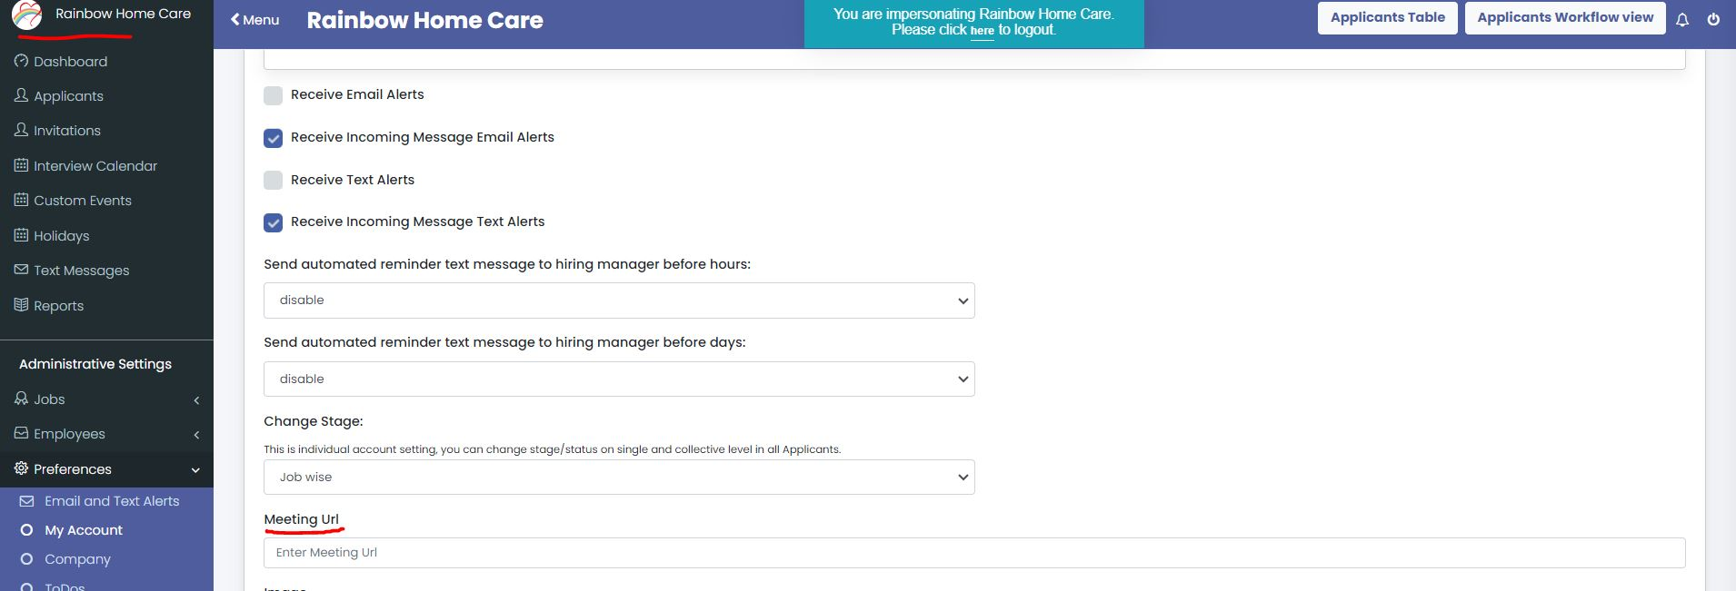
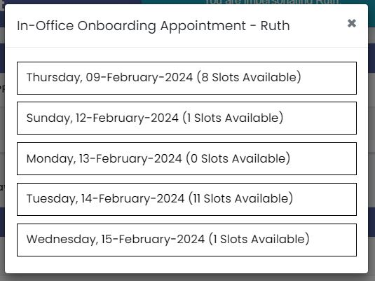
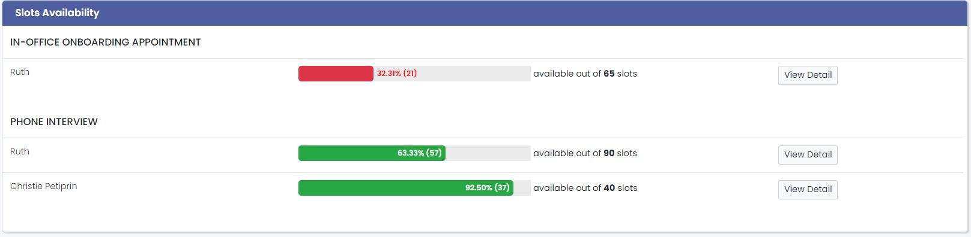
Reporting Updates/Additions
Dashboard Schedule Report Detail by:
  Source
  Day
  HOUR
  Days Scheduled to Appt.
My Upcoming Appts.
Recent Texts
Slots Available Dashboard Report
Meeting URL Link in Profile
Notes:
On your dashboard we have added some additional features within the Schedule Report. You can now see detail in more depth.
Source – You are spending a lot of money to drive applicants to your business. Now we can start to better understand what sources are producing the largest number of NO SHOWS, Failed Candidates and so on. This ability to dive deeper into the source data will allow for better decision making around applicants sources. Here you can see that we have our sources listed and which is producing the greatest number of no shows.
Day – Here we can see which day of the week is producing the largest number of no shows when applicants are applying. If we wanted to drill down into a particular sources we can use the dropdown to view this as well. Perhaps you will see that you have a large number of no shows from a particular source on a Friday, this will allow you to decide to not run ads on that day for that source and dedicate those dollars to other days and times that are producing a higher rate of qualified applicants who do show up.
Hour ­– Here you can see that we have the ability now to dive even deeper by looking at the hours of the day that are producing the highest no show rate. You can view this by source and dial it in even further by looking at individual days of the week. This may show you that you have a high number of no shows at say 9am on Monday and Tuesday so you may want to remove that time slot from your schedule to help avoid these.
# of Days from the time scheduled to the appointment – To take it a step further, you can now view by all source or individual and by all days or a particular day how many days candidate are waiting between the time they schedule their appointment and the actual date of the appointment. This will tell you a lot about your availability in the system and if you have enough open slots for interviews or perhaps you are allowing them to schedule too far into the future and should reduce the time frame shown on the scheduling calendar. If you have a high rate of no shows and the days between scheduling and the actual appointment is high you have your culprit.
My Upcoming Appointments displays the total amount of appointments you have scheduled by stage. Here you can see there are a total of 32 phone interview scheduled and 3 in person trainings. If I click on the view all I can see the detail of this. In this particular office we were able to identify that the phone interview time slots were 1 hour long and the availability of the person doing the interviews was becoming very limited resulting in applicants having to book further out which therefore increased the no show rate. By identifying this we can change the interview time from 1 hour to 30 minutes and double the capacity of the interviewer and shorten the time between scheduled and the actual appointment which then reduced the no show rate.
Recent Texts This is right next to the Upcoming appointments on the dashboard. This report is interactive and allow you to see any texts that come in and you have the ability to reply to them right on the spot without having to open their profile.
Slots Available – This section on the dashboard will display all of your hiring team (if you are an admin) or the individual hiring team member and their availability or capacity. You can see here that for the phone interviews Ruth has only 32% or 21 slots available from her 65 total slots. This display will show you Green if you are in good shape, yellow as you start to fill up and red when you are running out. If you have several hiring team members and two of them are always in the yellow or red and the other in green you need to adjust the appointments accordingly. Or if your team are all in the yellow or red then you either need to open up more capacity by expanding the calendar hours for appointments or perhaps its time to bring on a new team members. When you click on the view details button you can see each day and the slots available for that team member.
Meeting URL Link – You now have the ability to add a static link to your meeting source directly into the profile of each team member which will allow the system to pull directly into the messages that are sent to the applicants for video interview or online meetings. Click on your profile in the top left then scroll down to the Meeting URL section and enter your URL link.

Slide 8
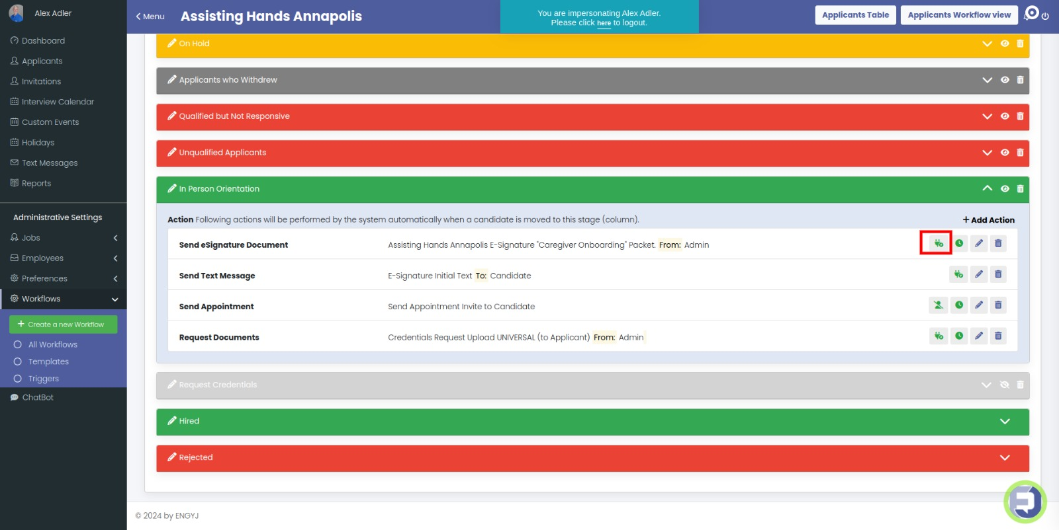
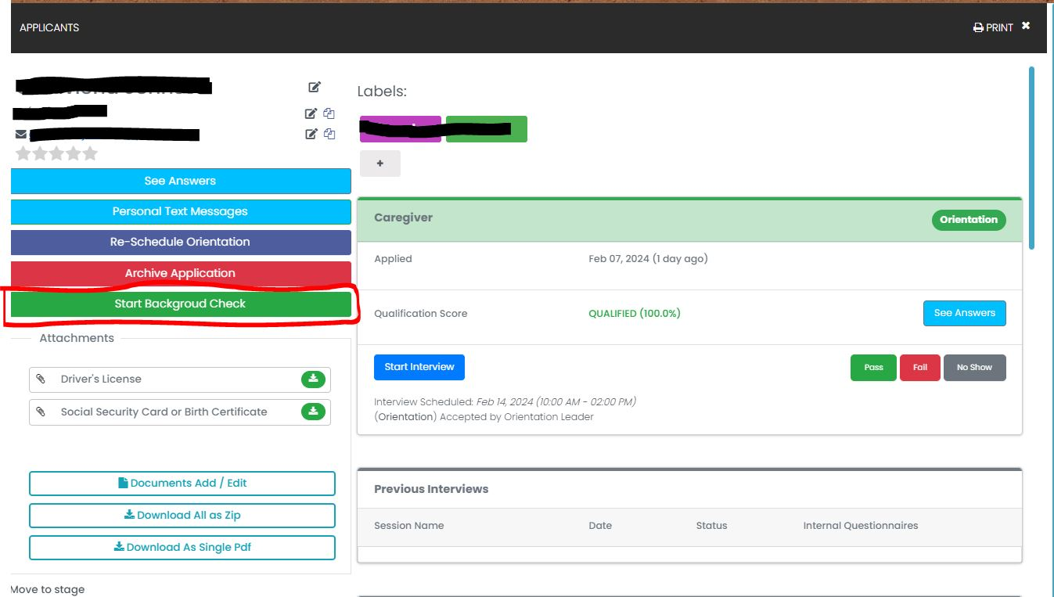
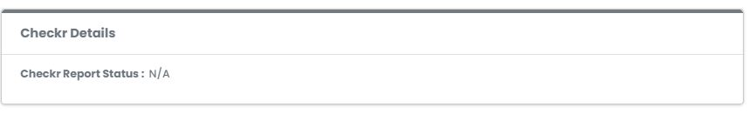
Add-On Updates
E-Signature Trigger can run after Interview Scheduled condition is added
Checkr Integration Complete and Active

Slide 9
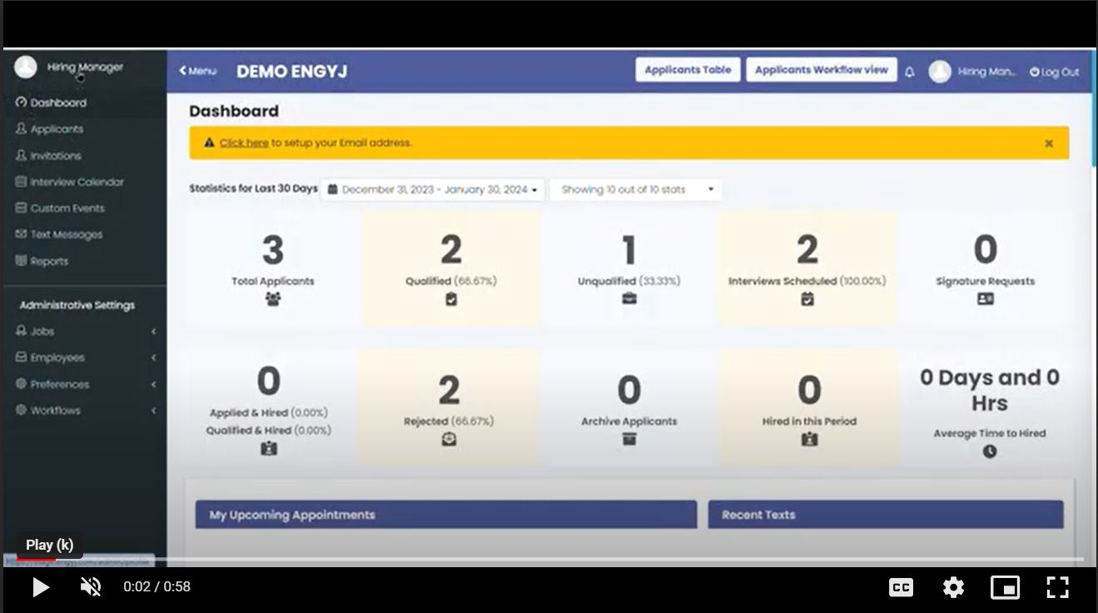
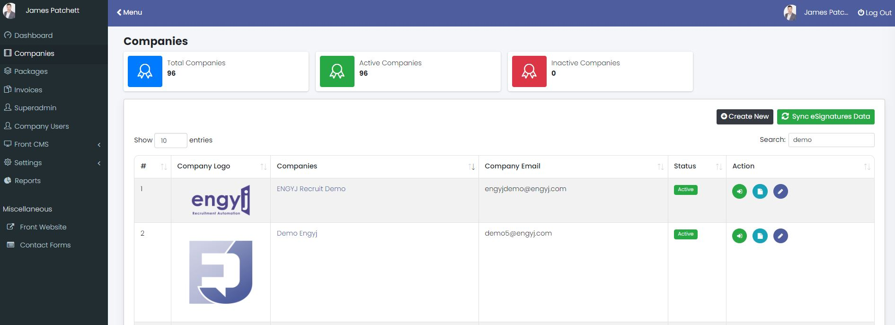


What’s Coming Next?
Super Admin Login – Multi Site Owners & Franchisors
Video Training Modules
API Connection with AXISCARE
API Connection with WELLSKY (Formerly ClearCare)
Additional API Opportunities

Slide 10
Software Questionnaire
Notes:
Following this meeting we will be sending out a questionnaire to all Owners to gather information on what systems you are using for your clients management, HR/Payroll, and background checks. This allows us to continue to integrate with other systems to make data transfer seamless.

Slide 11
Video Testimonial Contest
How to qualify:
  Send in a video testimonial detailing how ENGYJ has helped your business:
    Grow
    Become More Efficient
  Share Your Favorite Features
Keep it to one minute or less and have a clean/clear background
Submit by February 20th – Email James@ENGYJ.com for the link of where to upload
The Winner will receive lunch on us, for your entire office team!
Notes:
The winner will be determined by a random draw from all participants both past and present.

Slide 12
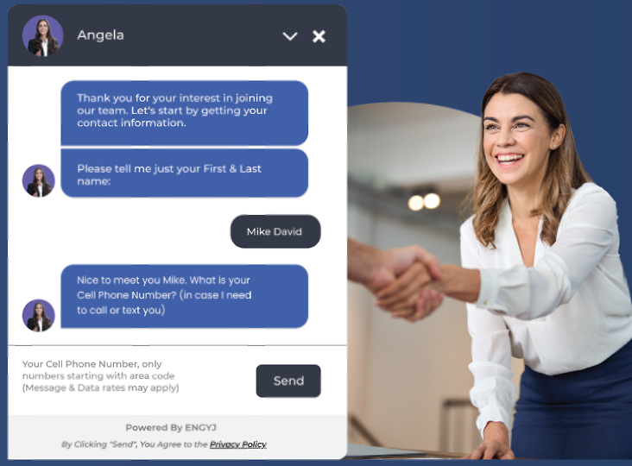
Need Assistance?
Please send an email to devteam@engyj.com and be sure to copy: James@engyj.com

Slide 13
We Appreciate You!
THANK YOU!

